Slide 1
PROJECT ONE (1)
AUSTIN POLICE DEPARTMENT 911 CALLS ANALYSIS
BY CLAUDIA OWUSU

Slide 2
INSIGHTS, OBSERVATIONS AND ANSWERS TO KEY QUESTIONS OF THE POLICE DEPARTMENT

Slide 3
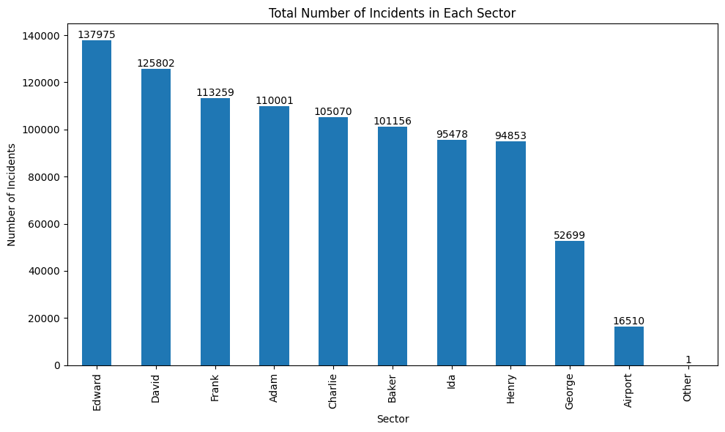
Total number of incidents that occurred in each sector

Slide 4
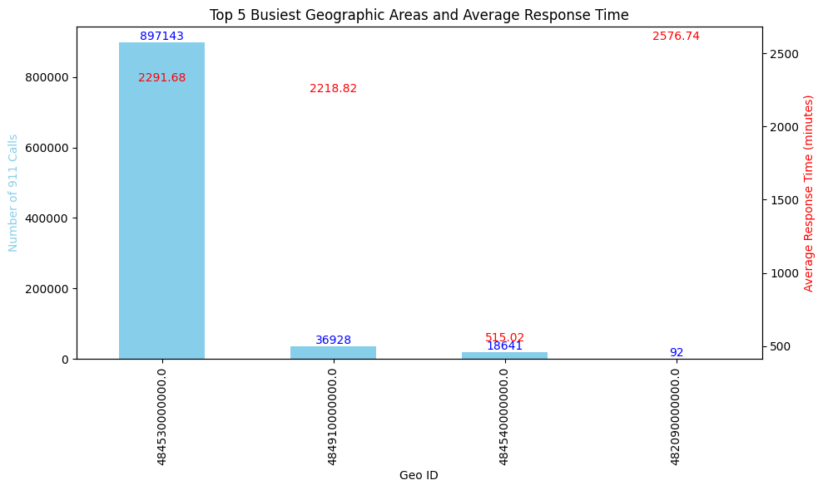
The top 5 busiest geographic areas in terms of 911 calls, and what is the average response time for each of these areas

Slide 5
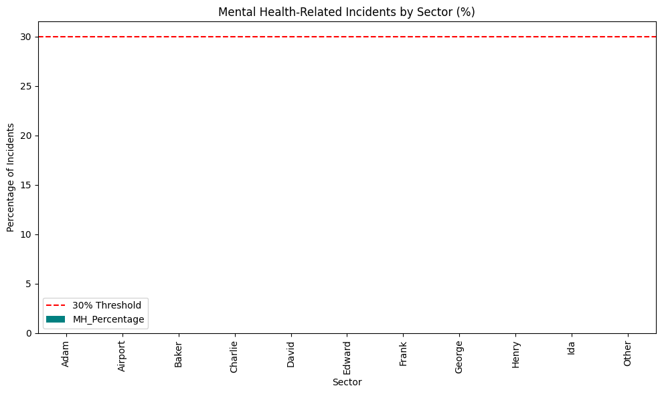
Identify sectors where mental health-related incidents make up more than 30% of the total incidents

Slide 6
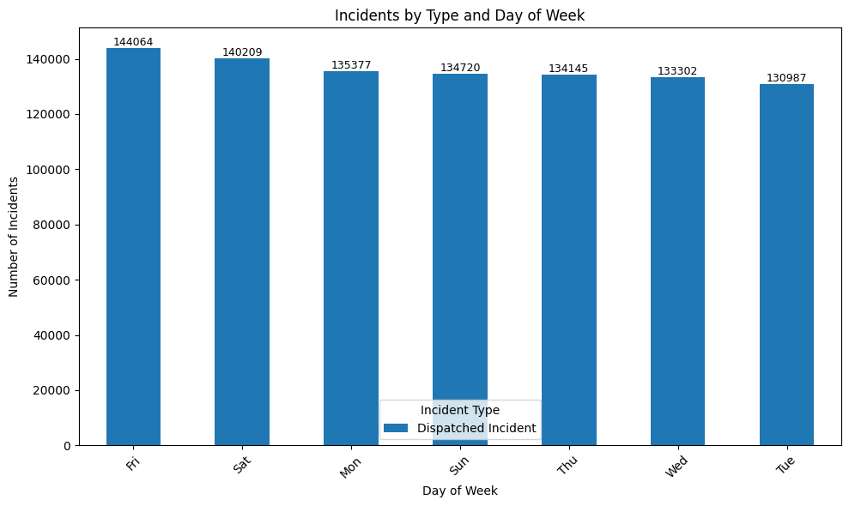
What are the busiest days of the week, and how do the types of incidents differ across those days?

Slide 7
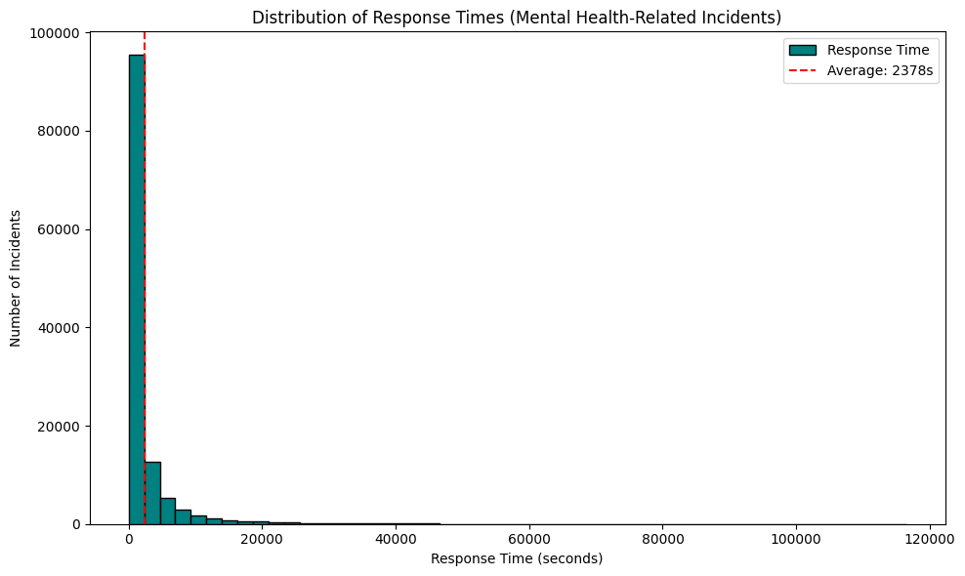
What is the average response time for all incidents involving mental health issues?

Slide 8
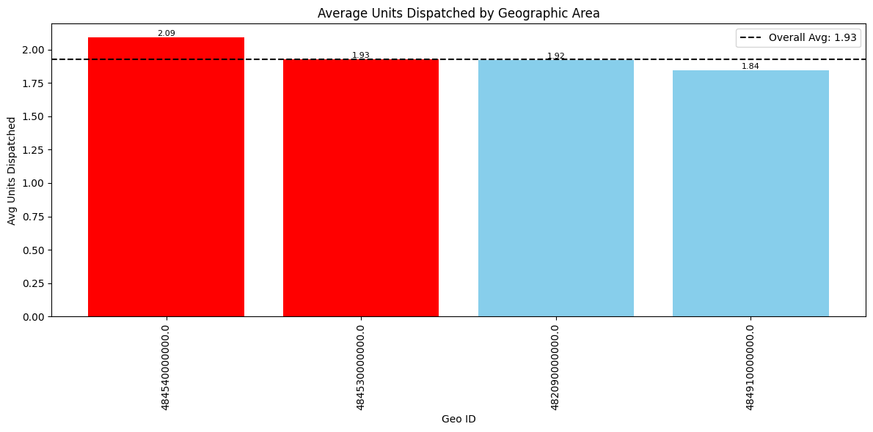
Find the geographic areas where the average number of units dispatched is greater than the average number of units dispatched across all areas.

Slide 9
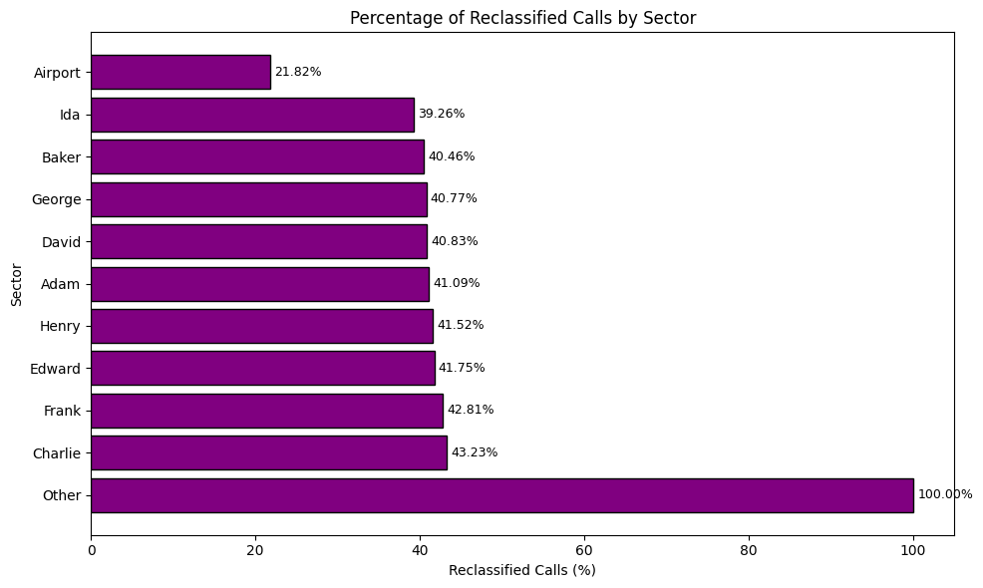
Which sectors have the highest percentage of reclassified calls (where the final problem description differs from the initial one)?

Slide 10
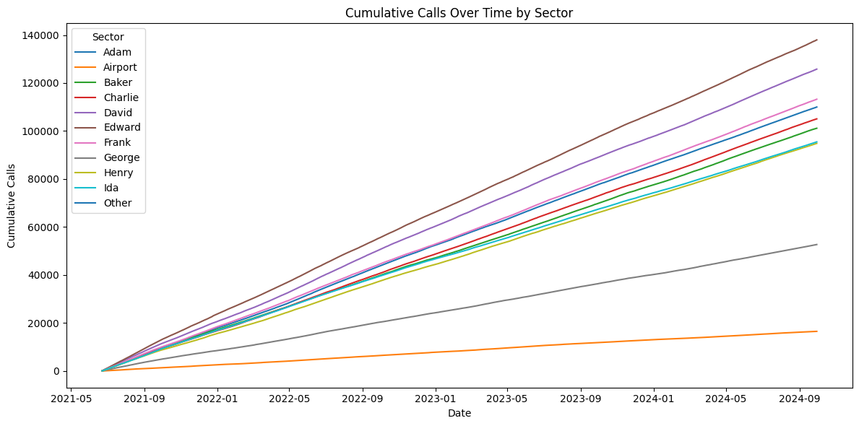
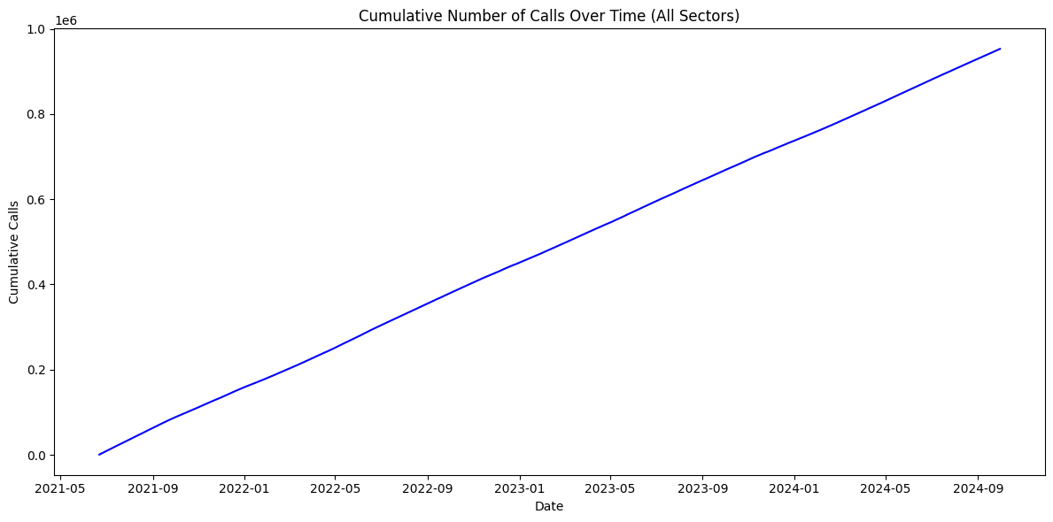
What is the cumulative number of calls throughout each day, and how does this cumulative total change by sector?

Slide 11
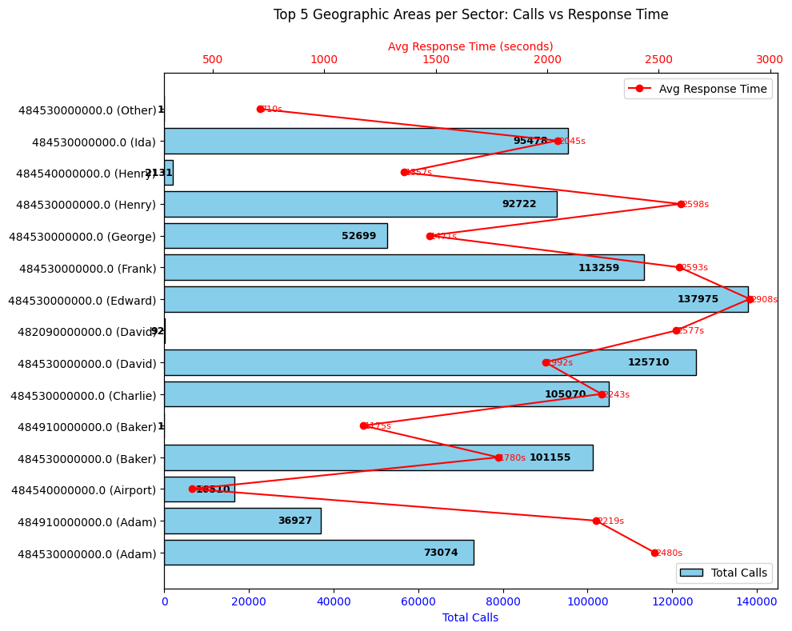
For each sector, rank the geographic areas by total number of 911 calls and show the response time for each area

Slide 12
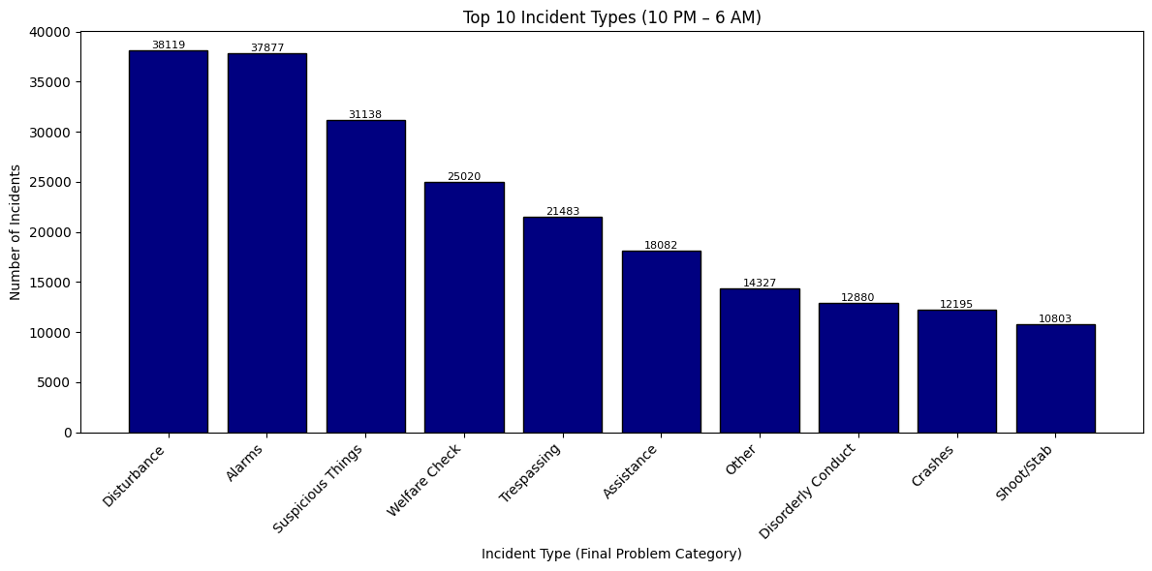
What are the most common types of incidents that occur between 10 PM and 6 AM?

Slide 13
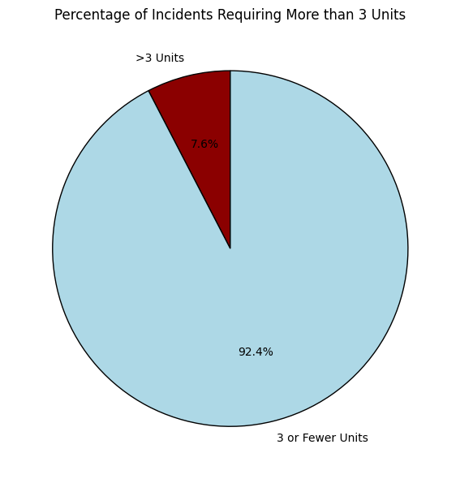
What percentage of incidents required more than 3 units to be dispatched

Slide 14
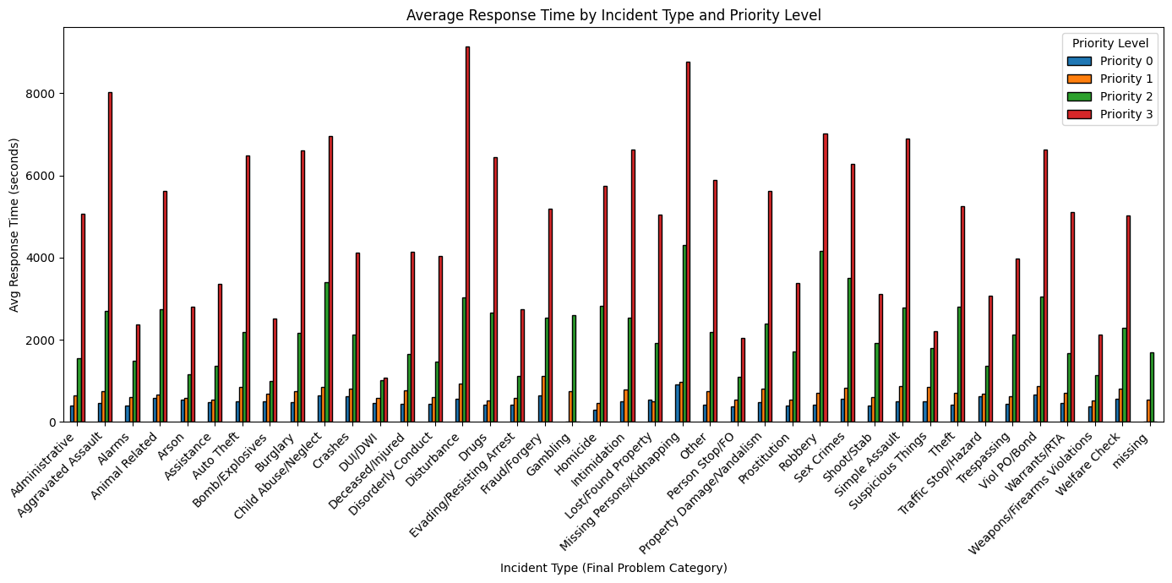
How do response times compare across different priorities for each type of incident?

Slide 15
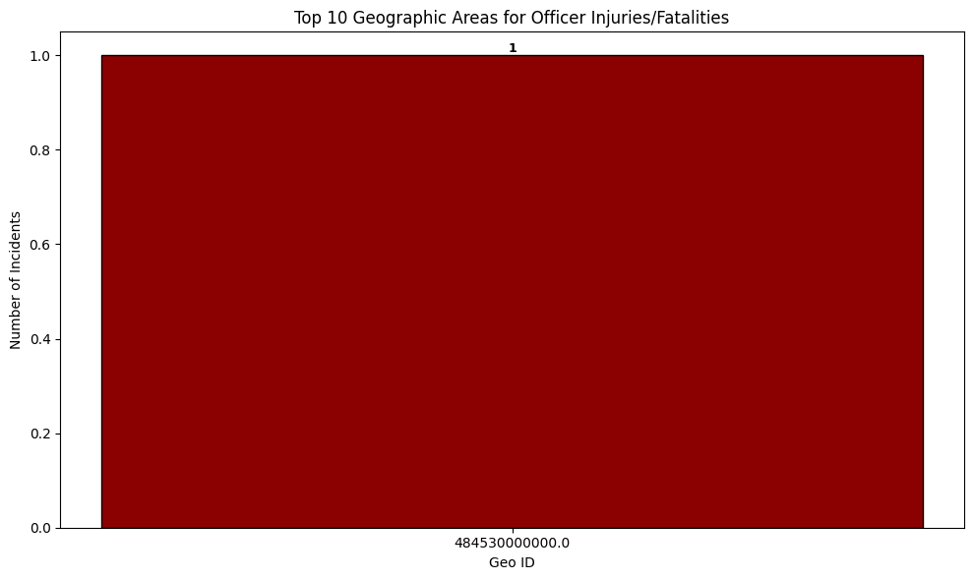
Which geographic areas have the highest number of incidents involving officer injuries or fatalities?

Slide 16
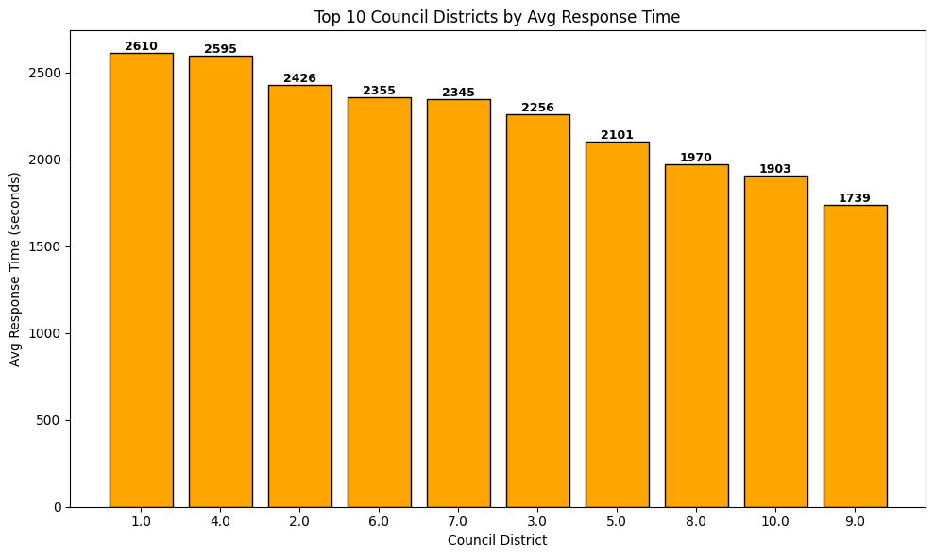
Which council districts have the highest average response times?

Slide 17
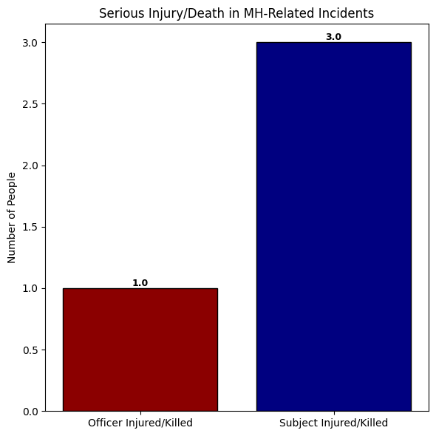
How many incidents involve serious injury or death (either officers or subjects) related to mental health?

Slide 18
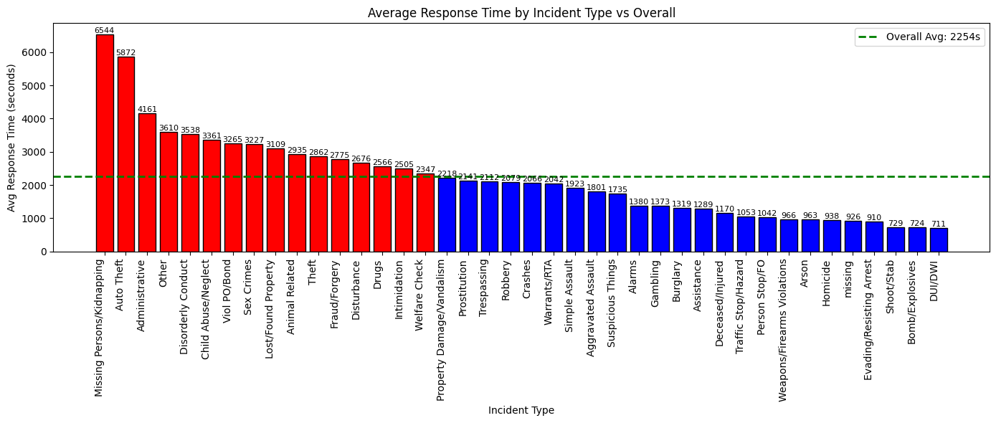
Find the average response time for each incident type and compare it with the overall average response time

Slide 19
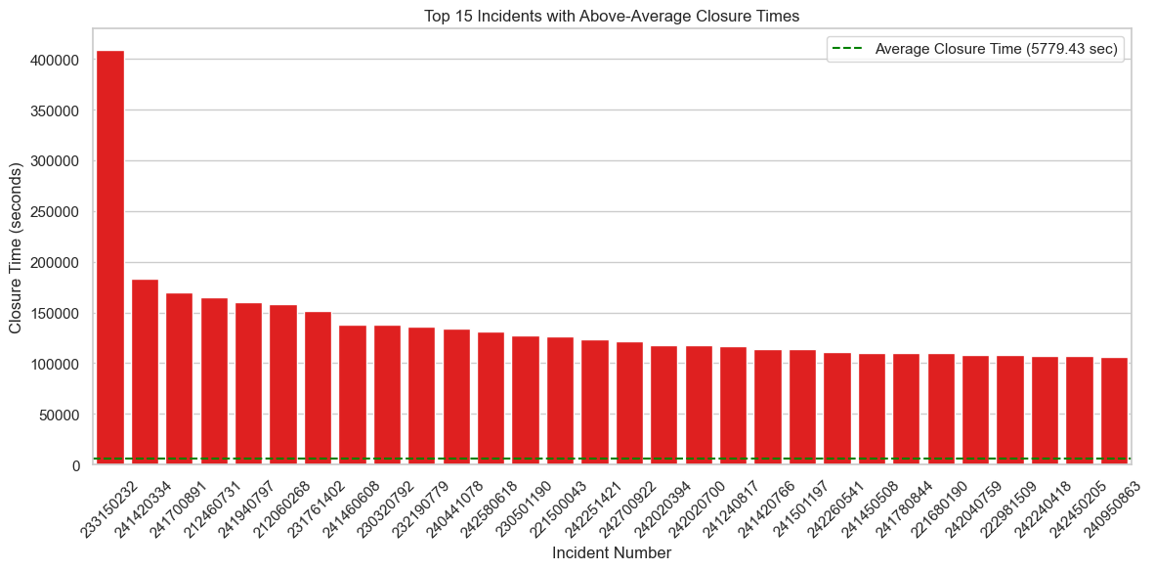
Which incidents have closure times that are longer than the average closure time for all incidents?

Slide 20
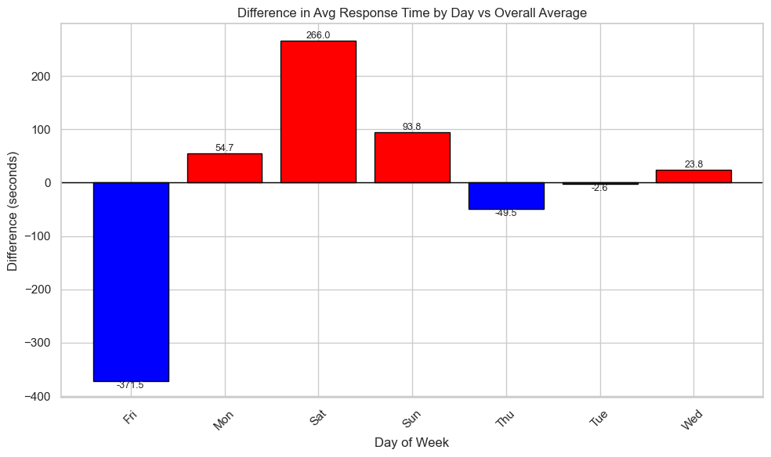
For each day of the week, calculate the difference between the average response time for that day and the average response time for all days combined

Slide 21
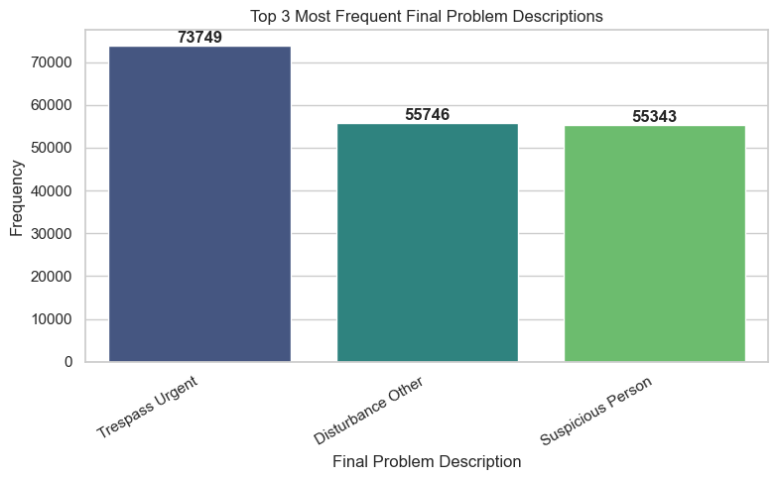
What are the top 3 most frequent final problem descriptions?

Slide 22
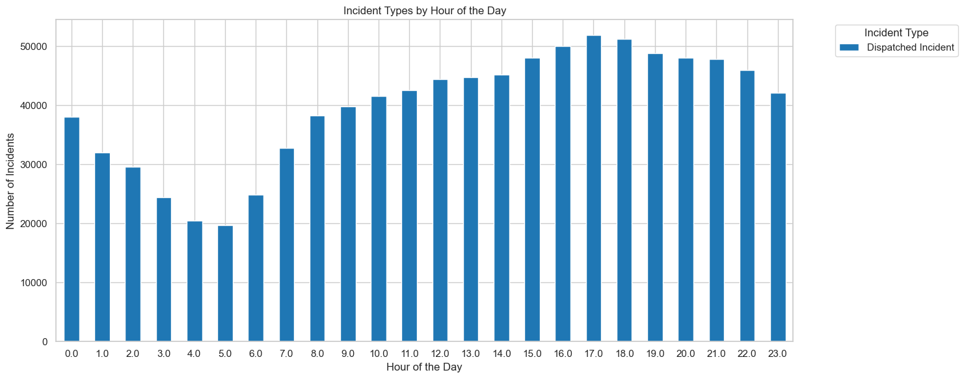
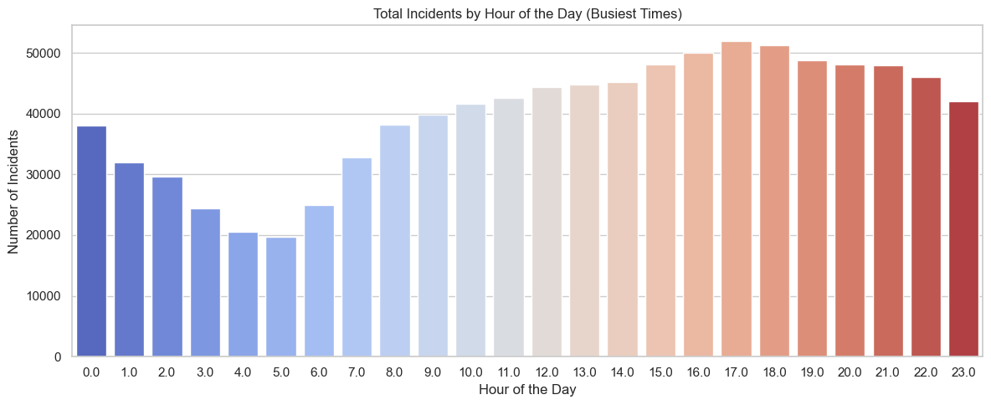
What are the busiest times of the day, and how do incident types vary by time?

Slide 23
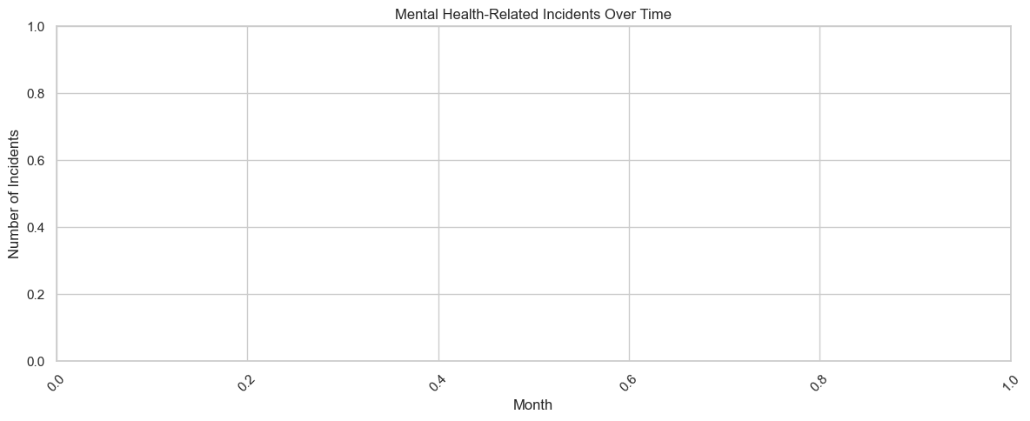
What is the total number of mental health-related incidents, and how has this changed over time?

Slide 24
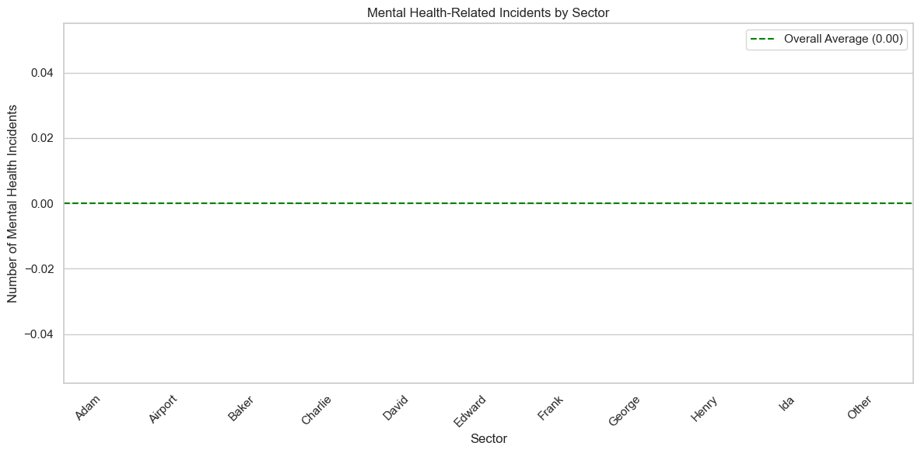
Which sectors have above-average mental health-related incidents compared to the overall average for all sectors?

Slide 25
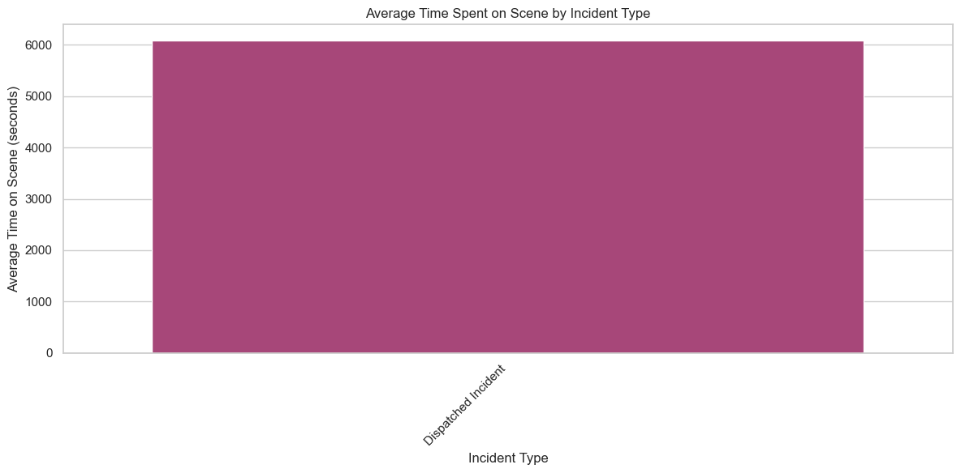
What is the average time spent on scene by units across different types of incidents?

Slide 26
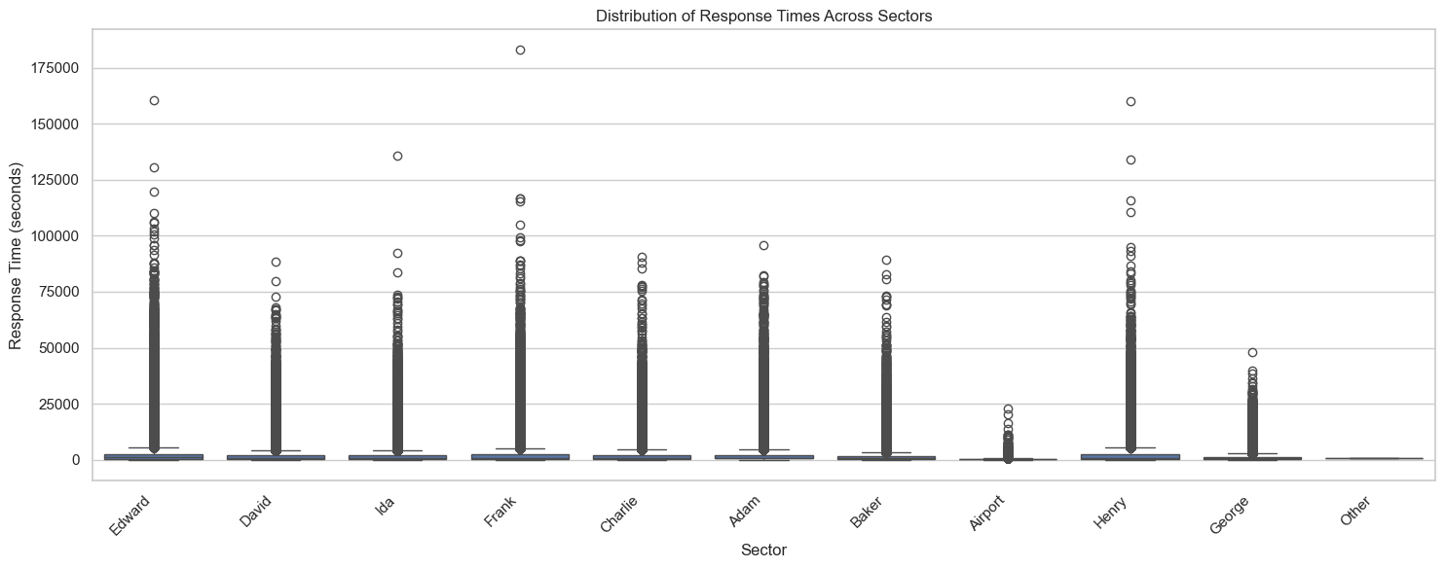
What is the distribution of response times across the sectors, and which sectors have the fastest and slowest response times?

Slide 27
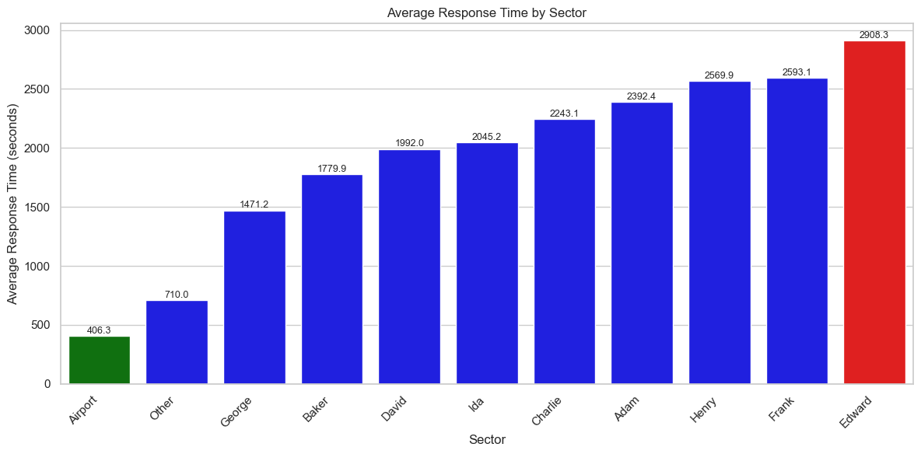

Slide 28
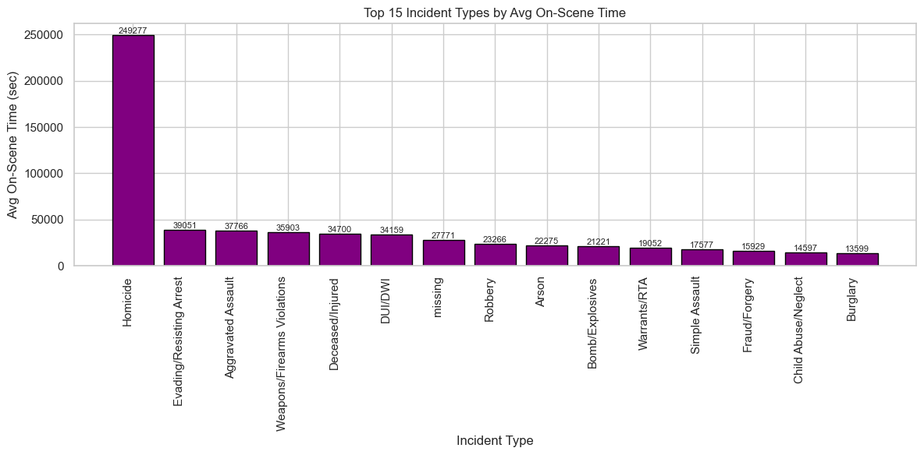
Which incidents have the longest on-scene time, and how does this correlate with the incident type or priority level?

Slide 29
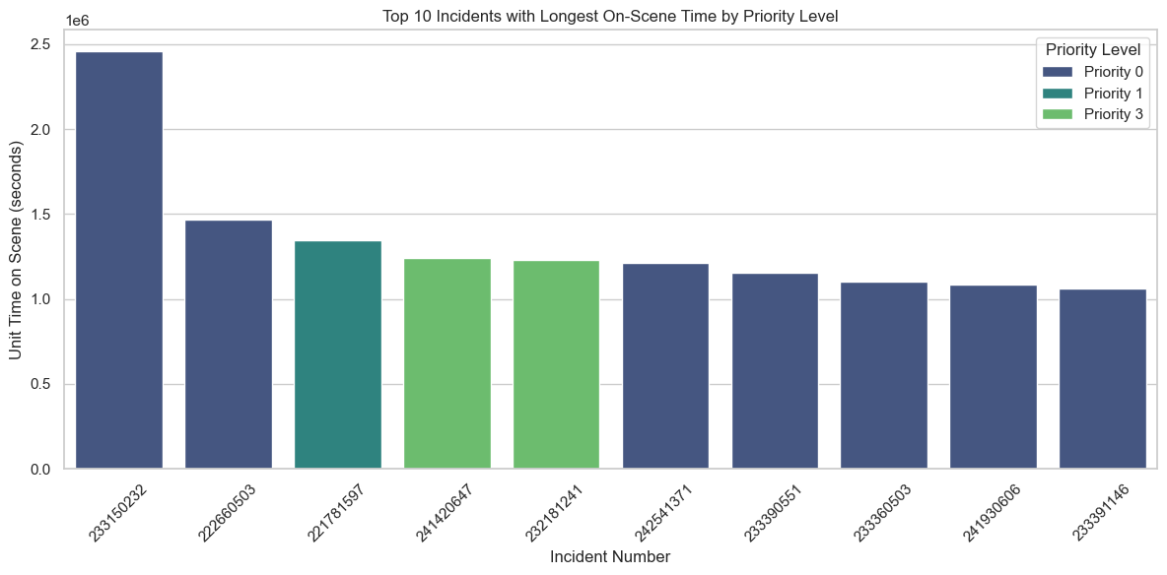

Slide 30
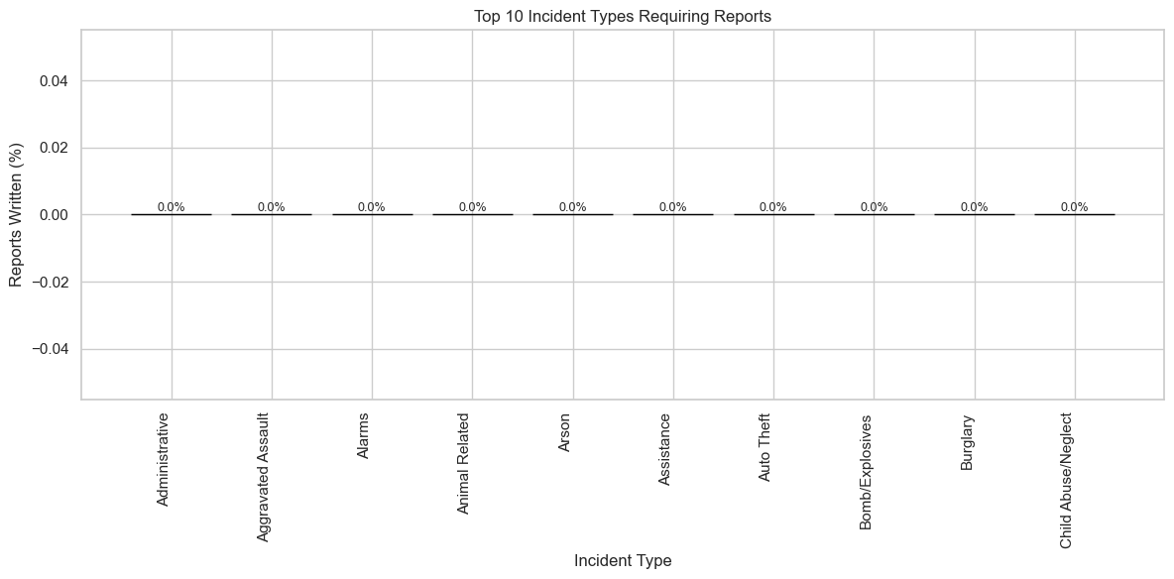
Which types of incidents typically require reports to be written, and how frequently do these occur?

Slide 31
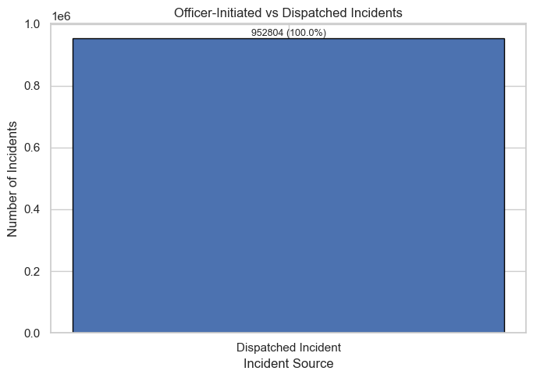
How many incidents were initiated by officers in the field compared to those dispatched via 911 calls?

Slide 32
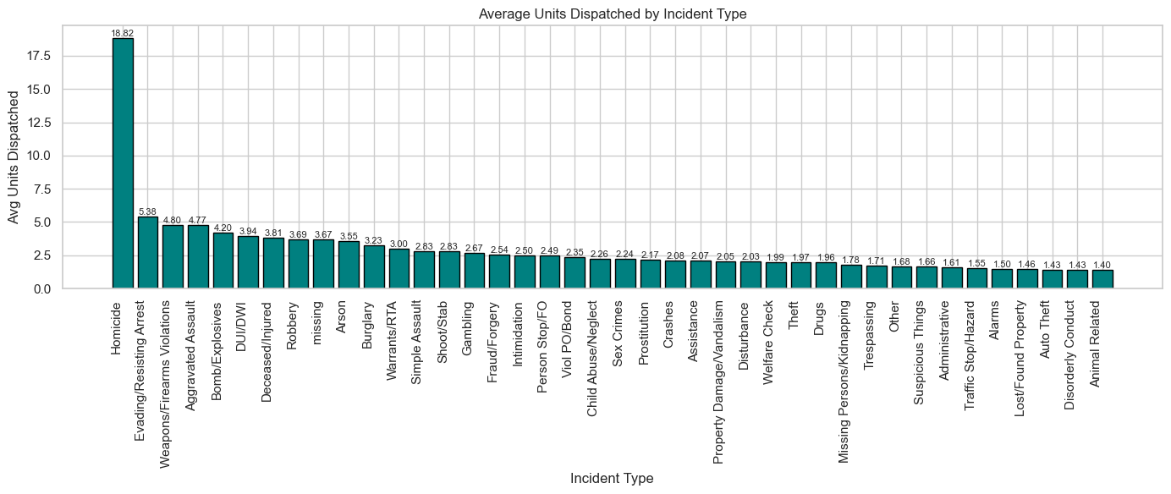
What is the average number of units dispatched to incidents based on the incident type?

Slide 33
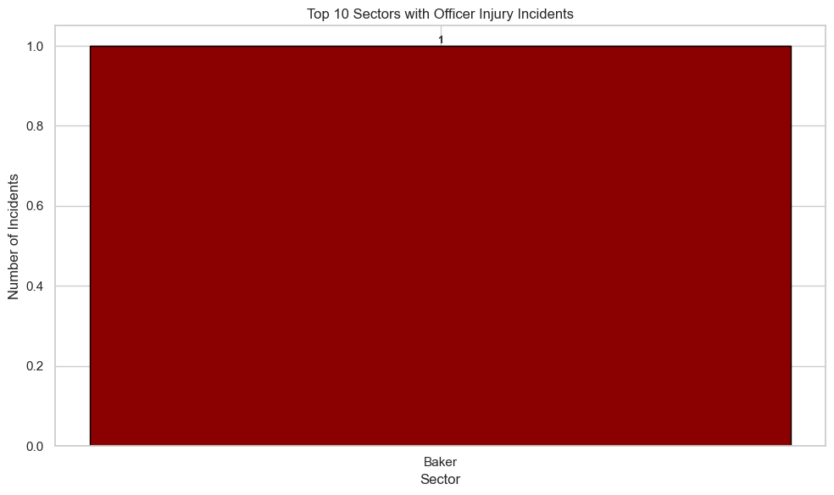
How do incidents involving officer injuries correlate with mental health-related flags, and which sectors have the highest occurrence of these incidents?

Slide 34
The Recommendations
Reduce Response Times for Critical Calls by Adjusting Unit Deployment
Use data on call priority and sector workload to realign police units so high-priority incidents get faster responses, improving overall community safety and officer effectiveness
Create Specialized Mental Health Units in High-Impact Areas
Focus additional training and resources on sectors with a high percentage of mental health-related calls to lower incident escalation and enhance officer and citizen wellbeing

Slide 35
Recommendations
Implement Daily Monitoring of Incident Trends and Resource Use
Track call volumes, response times, and incident reclassifications regularly to identify emerging issues early and adjust staffing or protocols before problems worsen.
Improve Accuracy in Incident Reporting and Classification
Train dispatch and officers to reduce mismatches between initial and final call categories, ensuring appropriate responses and better data for future planning and community trust.

Slide 36
THANK YOU

